Slide 1


Plant Disease Detection
By: Aashrey Jain

Slide 2
Table of Contents-
Introduction
Problem Statement
Dataset Description and Model Architecture
Flowchart
Training Process
Accuracy Results
Benefits of the system
Limitations and Future Scope
Conclusion

Slide 3
What is Plant Disease Detection? - Identifying symptoms of diseases in plants for timely intervention. Why is it Important? - Reduces crop loss, ensures food security, and automates detection. Role of AI in Detection - CNNs automate plant disease detection with speed and accuracy.
INTRODUCTION

Slide 4

Current Challenges: - Manual inspection is time-consuming and subjective. - Early detection requires expertise. Objective: - Build a CNN-based model for classifying plant images into healthy and diseased categories.
PROBLEM STATEMENT

Slide 5
Dataset Description and Model Architecture * Dataset: PlantVillage Dataset. - Categories: Healthy and diseased plants. - Preprocessing: Resizing, Rescaling, Validation Split, One-Hot Encoding and data augmentation. Input: Image (e.g., 224x224). * Layers: - Convolution(Extract features (edges, textures)), Max-Pooling(Reduce dimensionality and prevent overfitting), Flatten(Convert 2D feature maps to 1D for dense layers), Dense(Combine features for classification), Dropout(Prevent overfitting by randomly disabling neurons). * Frameworks: TensorFlow, Keras.

Slide 6
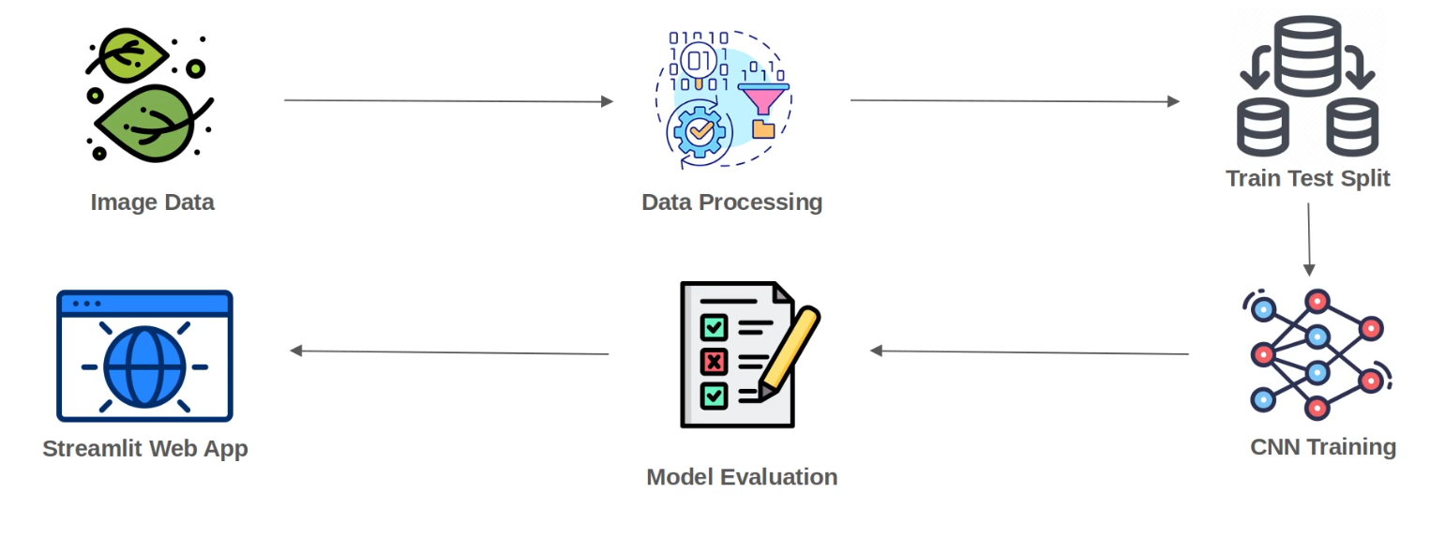
FLOWCHART
The below flowchart provide the step wise process of the project-

Slide 7
Training Parameters: - Optimizer: Adam, Loss Function: Categorical Crossentropy. - Epochs: 15, Batch Size: 32, Validation Split: 20%. Evaluation Metrics: Accuracy, Precision, Recall, F1-Score.
Training Process

Slide 8
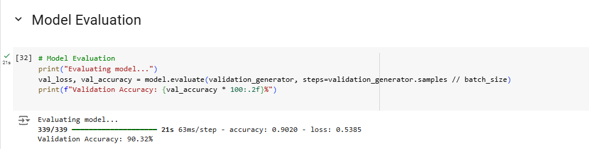
Accuracy Results
The model has achieved a good accuracy of 90.32%.

Slide 9
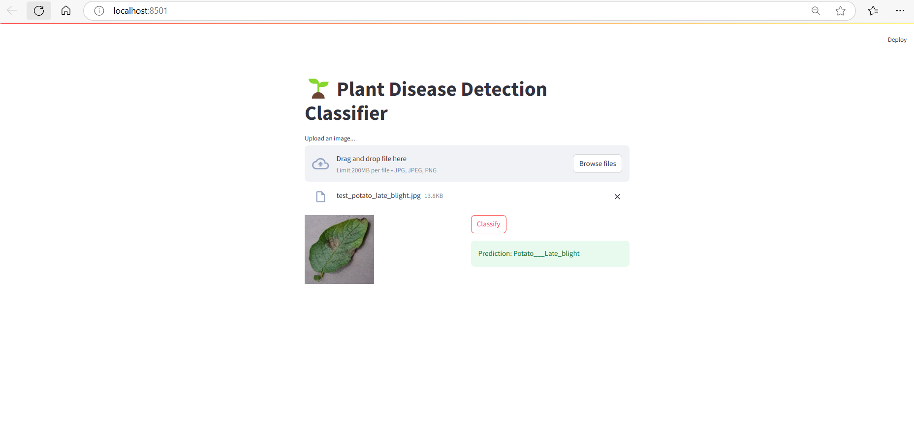
Plant Disease Detection Classifier App
Plant Disease Detection App is created using Streamlit library in PyCharm. This will enable us to view the prediction in more convenient manner.
Functionality-
As from the image its clear that first we need to click on Browse Files and choose the test image for checking the prediction. As the image is visible, we need to click on the Classify button to check the prediction.

Slide 10




Benefits of the System
There are various benefits of this system that includes-
Real-time disease detection.
Cost-effective and scalable.
Minimal human intervention required.

Slide 11
Limitations and Future Scope
Limitations:
Requires high-quality images, potential dataset biases.
Future Improvements:
Use diverse datasets, use some pretrained models to increase the accuracy even further, deploy as mobile app, suggest treatments.

Slide 12
Conclusion
Summary: CNN advances precision agriculture by automating disease detection.
Impact: Improves crop yield, reduces losses, empowers farmers.
Call for Research: Further development and practical implementation.

Slide 13
Thank you so much

